Slide 1
Lyot Coronagraph and DM Optimization
Leonello

Slide 2
Defining the Lyot Coronagraph
Initial pupil plane WF (star + exoplanet)
Apply DM 1
Gaussian / 8th Order Mask in FP1
Propagate to Lyot Plane (apply Lyot Stop)
Apply DM 2
Propagate to FP 2

Slide 3
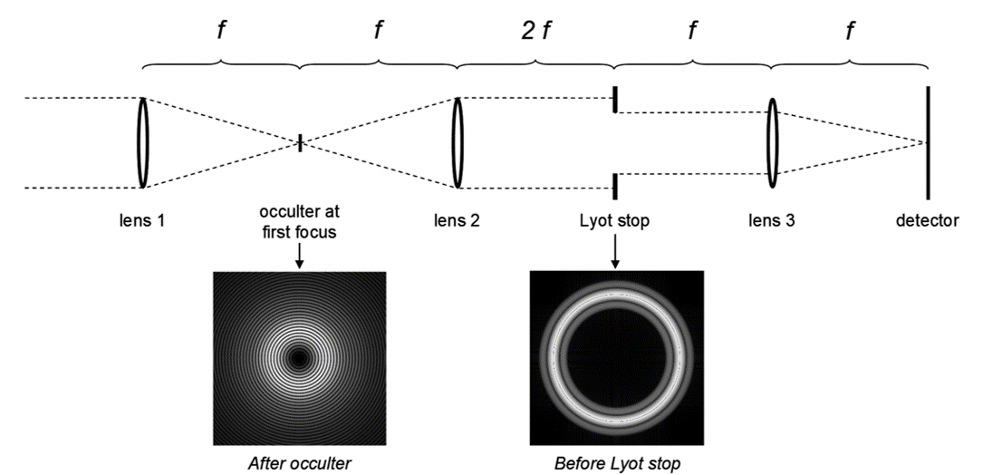
DM 1
DM 2

Slide 4
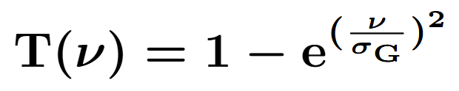
Initial Parameters (No DMs / Aberrations)
Planet-To-Star Contrast = 10^-14 to 10^-12
Planet Offset (FP): 15 lambda/D
Gaussian Width (FP): 5 lambda/D
Lyot Stop Diameter / Pupil Diameter = 0.7

Slide 5
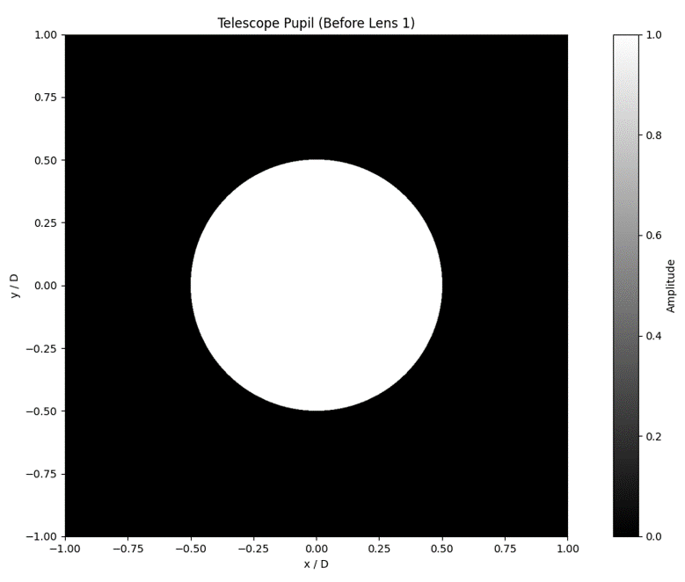

Slide 6
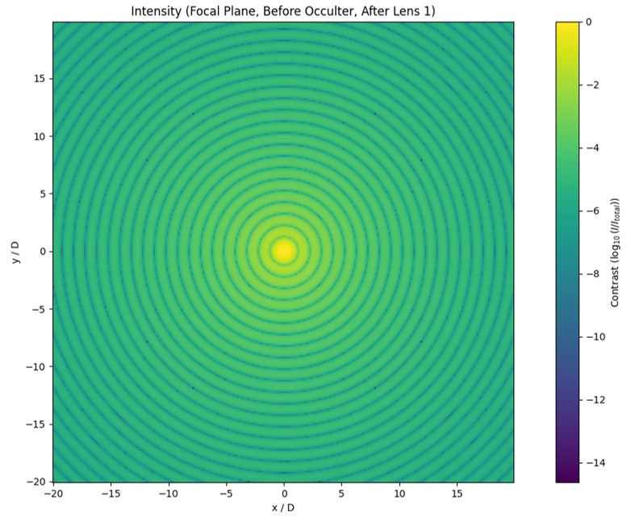

Slide 7
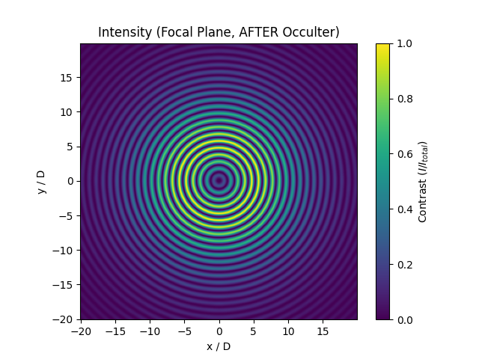

Slide 8
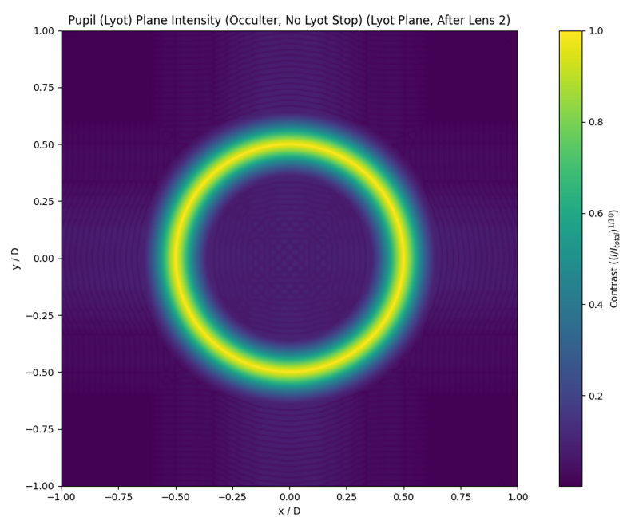

Slide 9
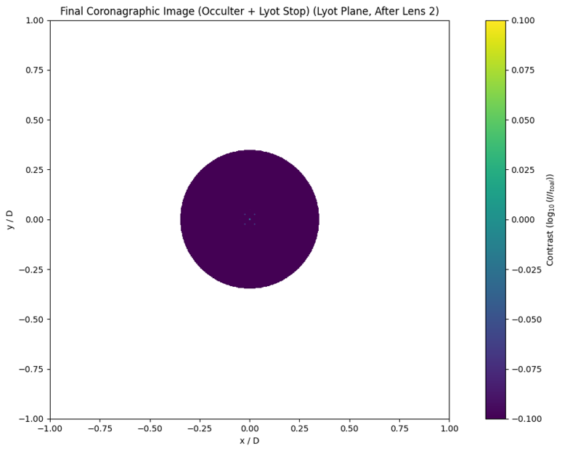

Slide 10
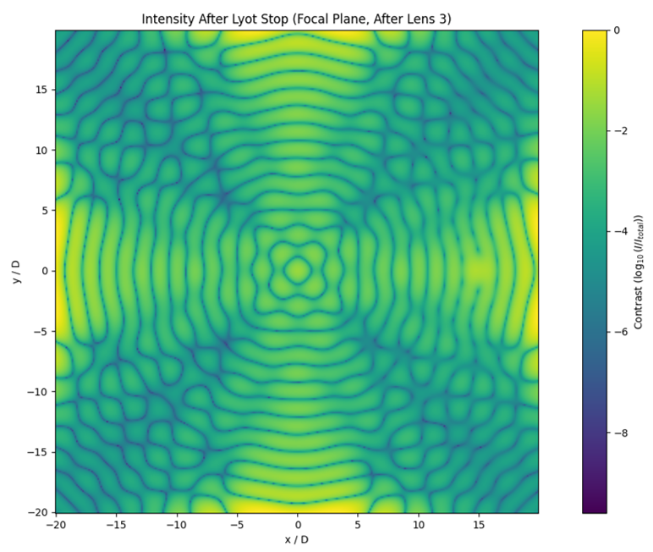

Slide 11
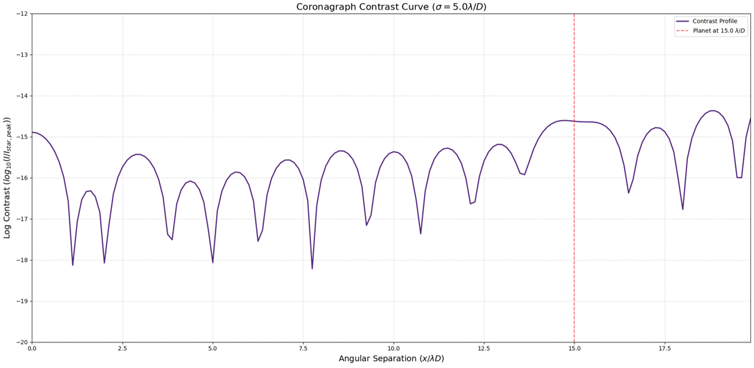

Slide 12
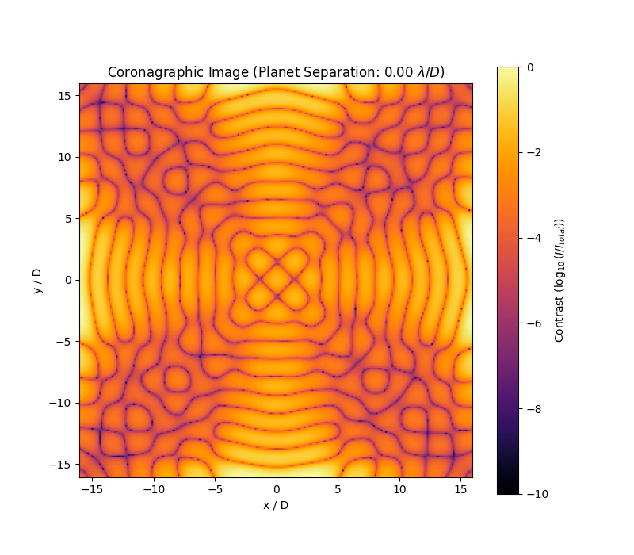

Slide 13
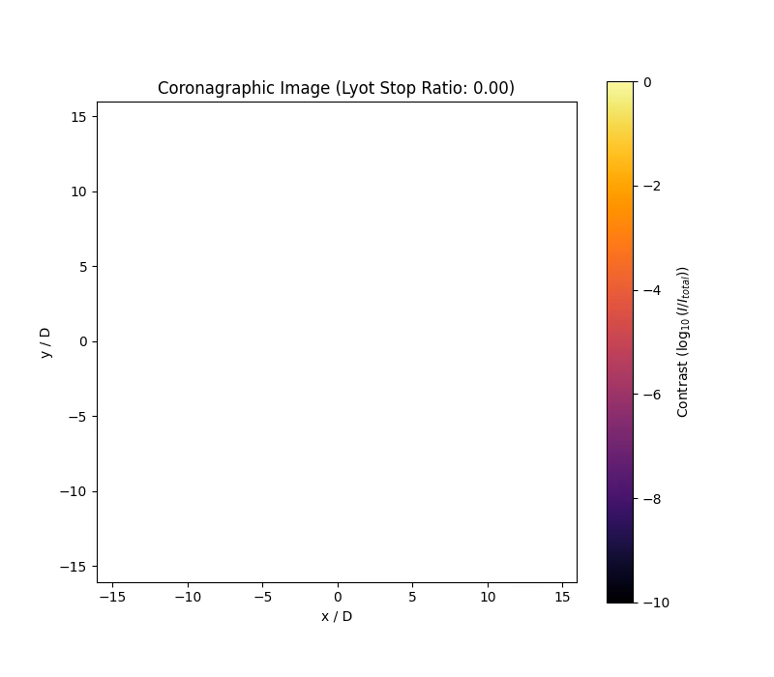

Slide 14
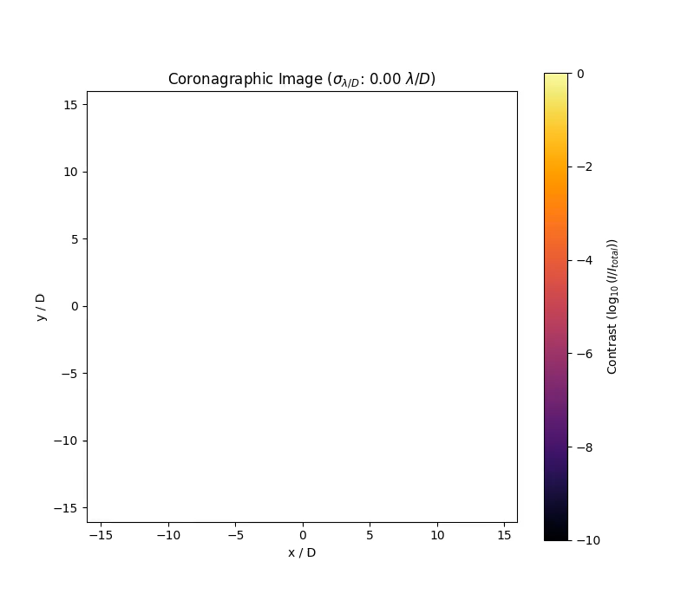

Slide 15
Introducing Aberrations and DMs
DM 1 in Pupil Plane / DM 2 in Lyot Plan
Simulation of 2 Continuous DMs and 1 HSM
Piston, Tip, Tilt (PTT) Mode Bases
DM Influence Functions (DM PTT Coefficients)
Random Zernike Basis (PTT) for incoming WF

Slide 16
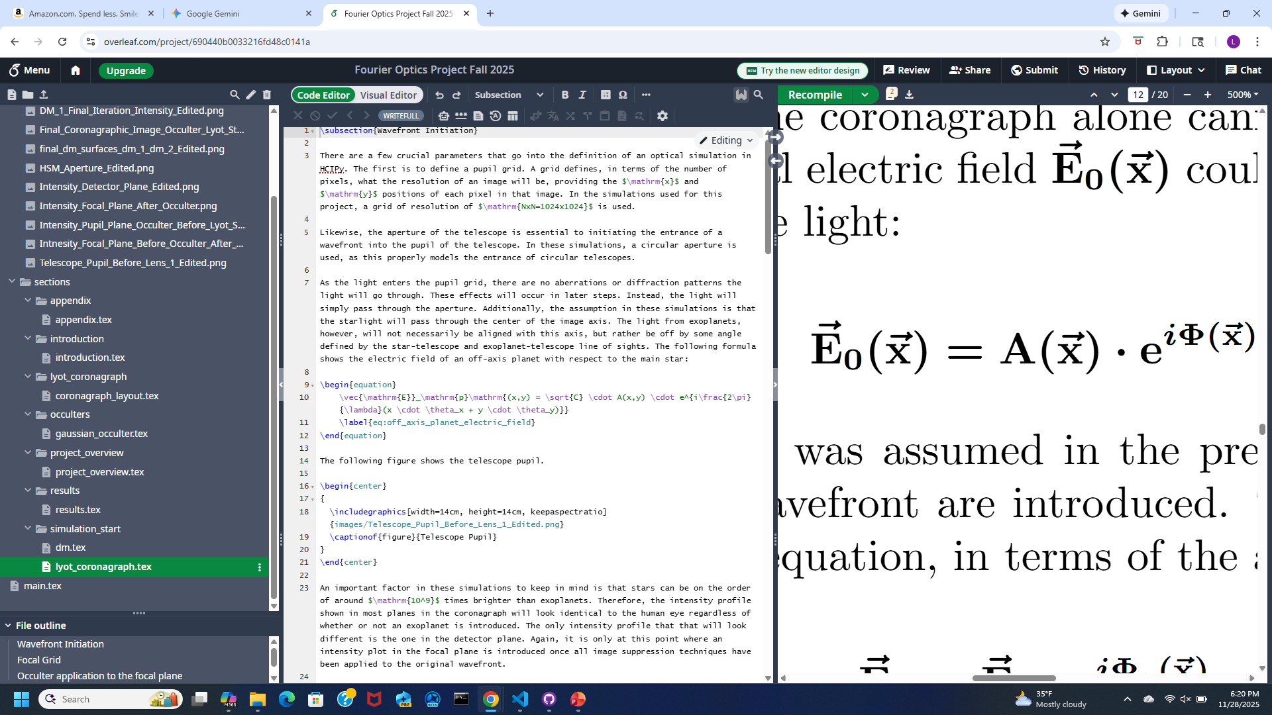
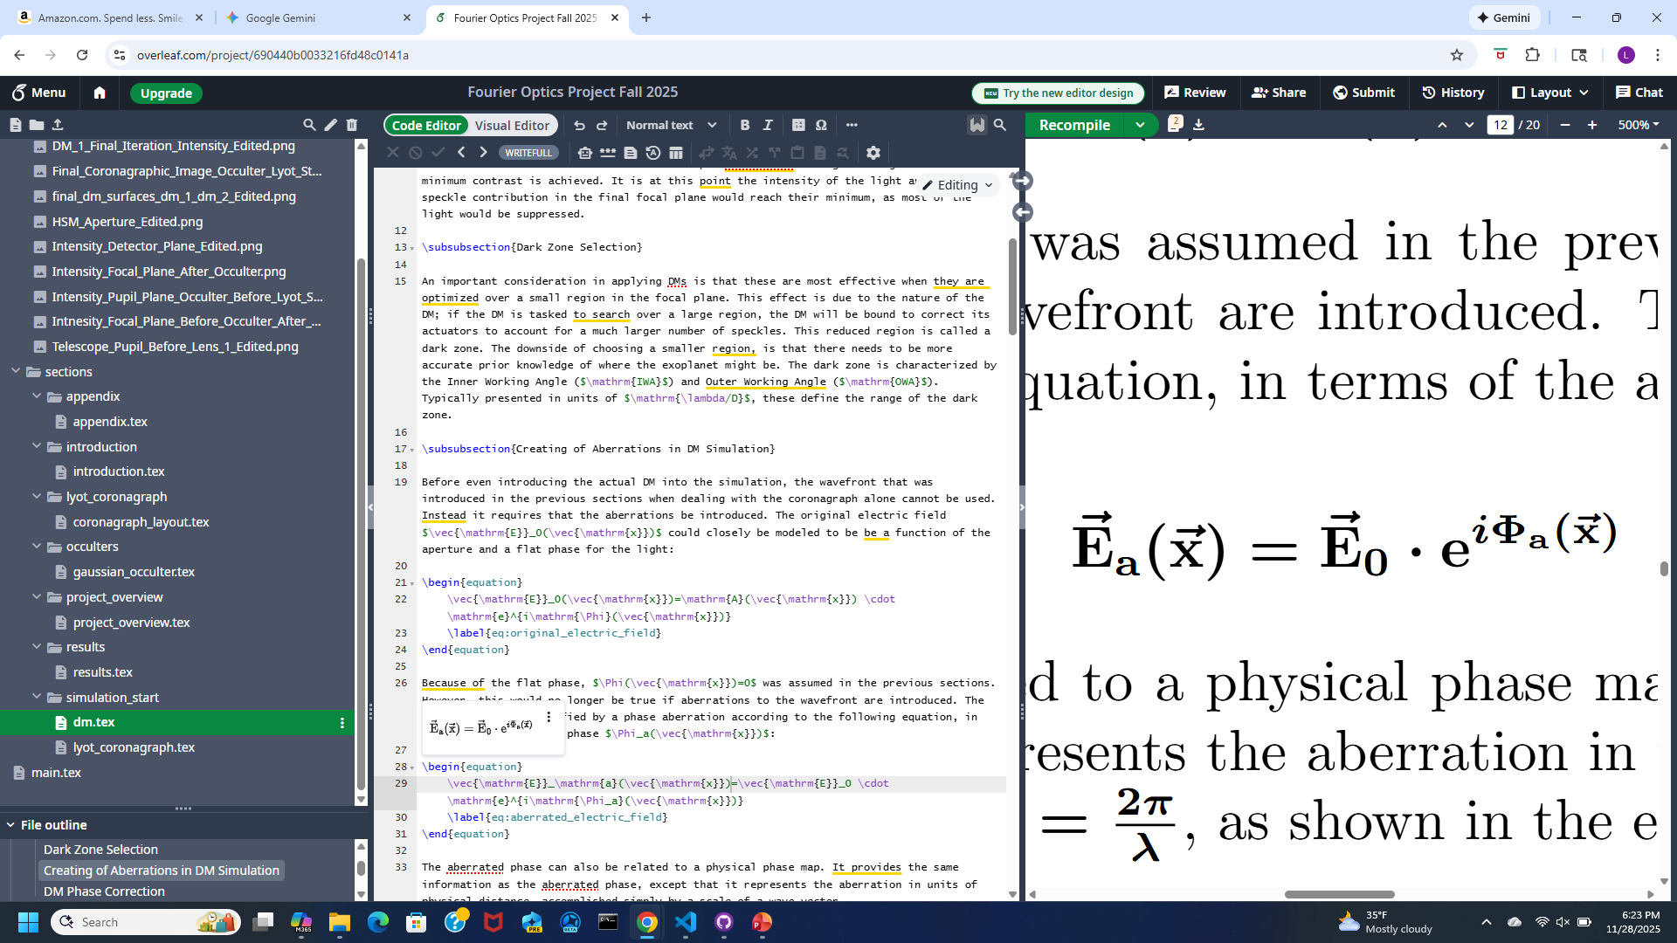
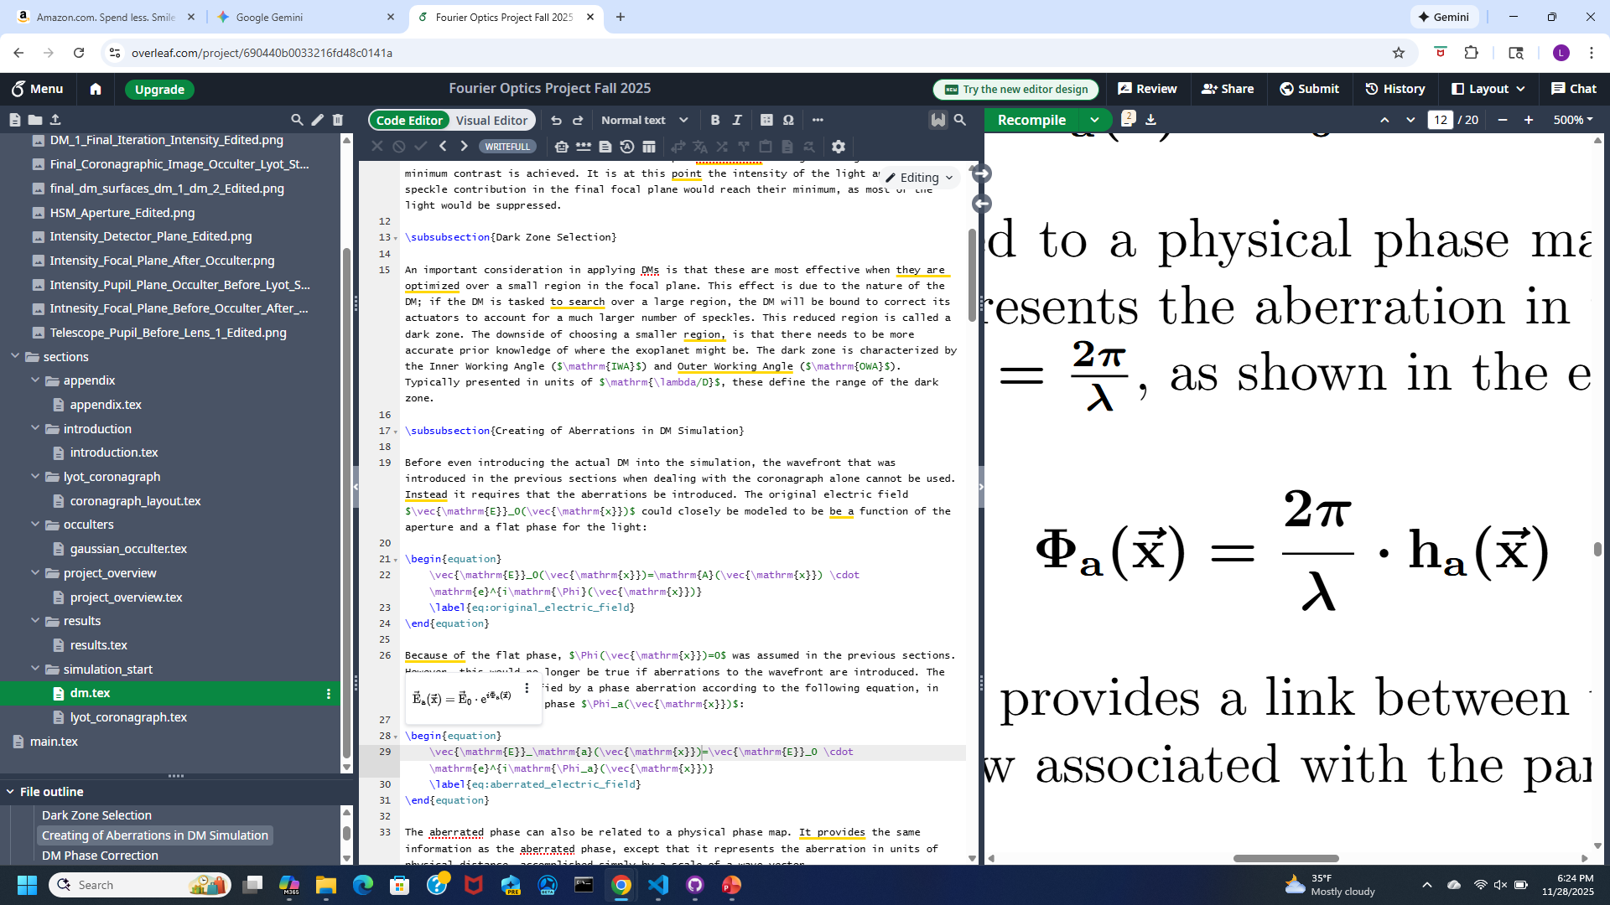
Aberrations

Slide 17
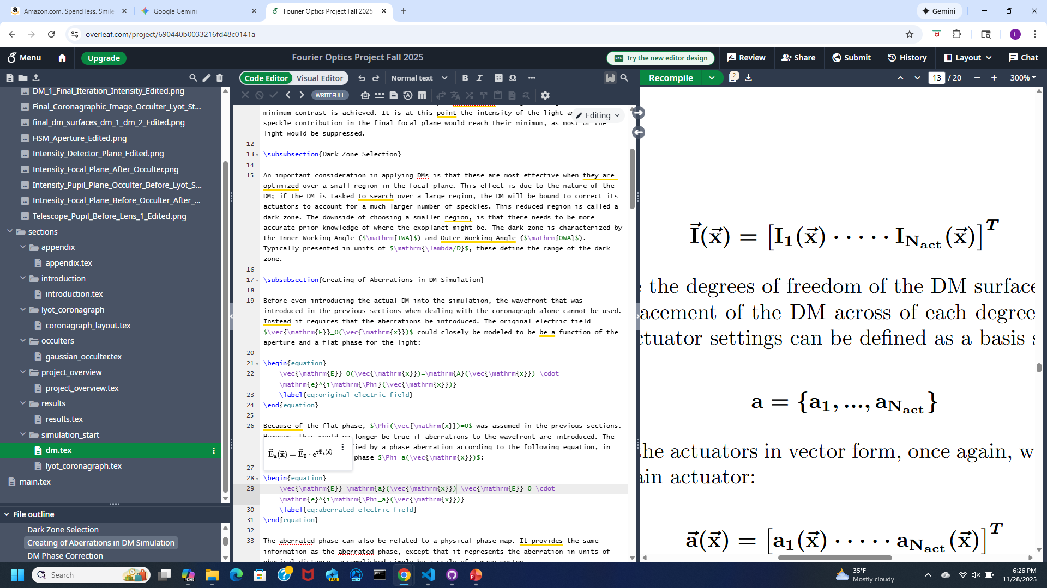
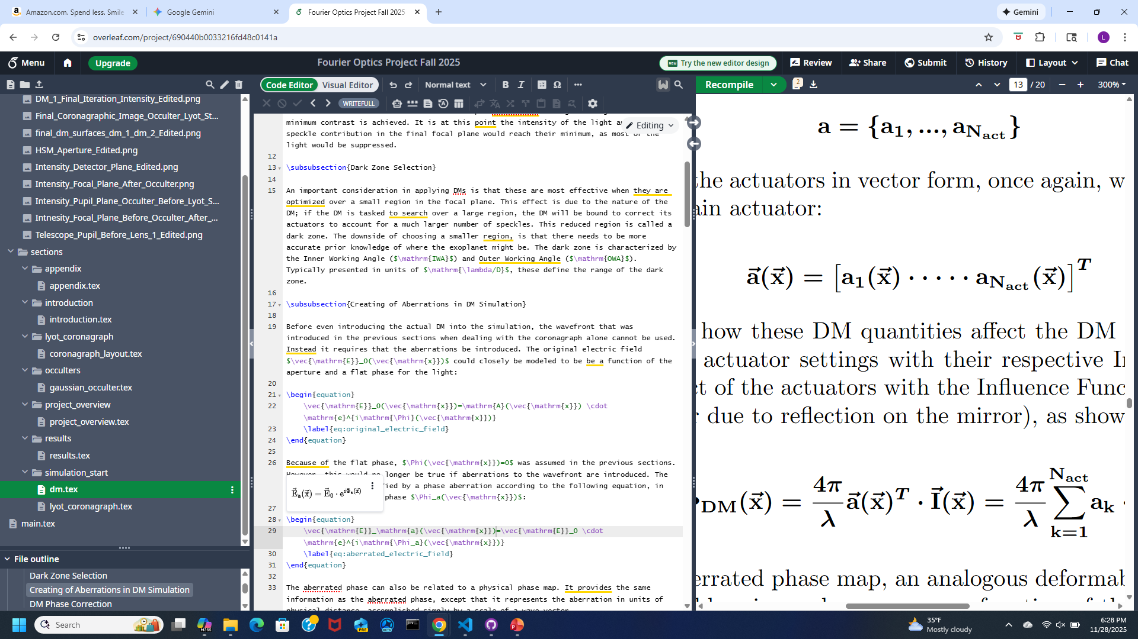
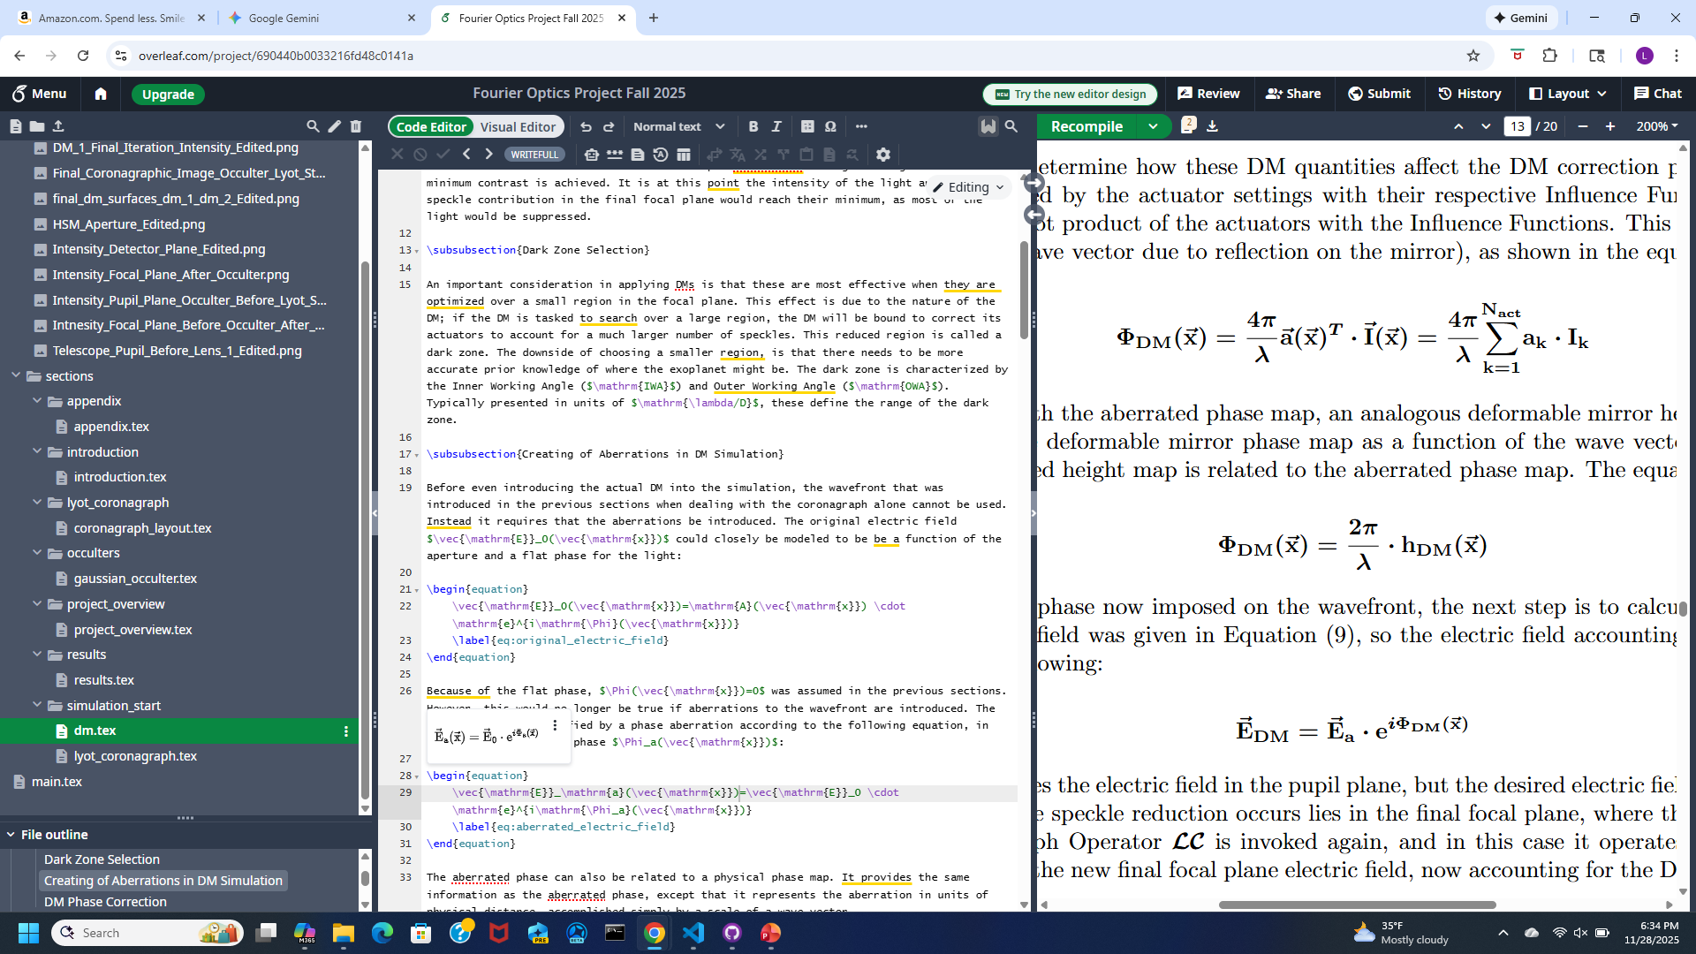
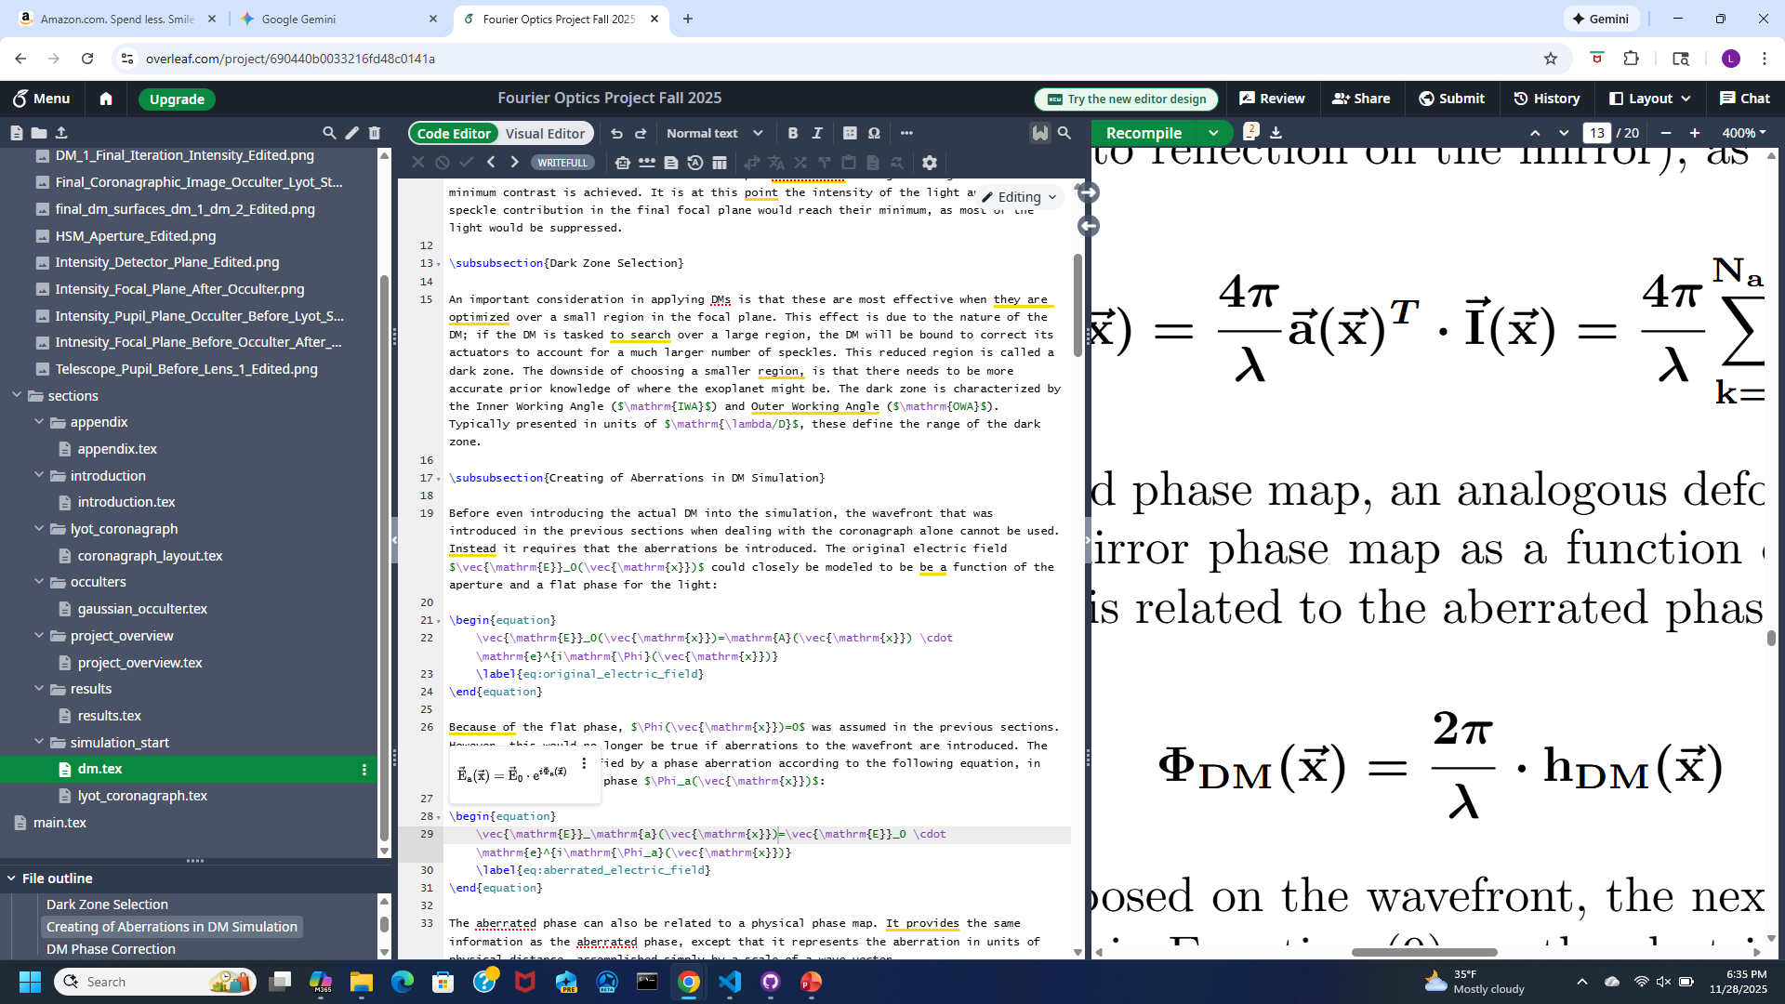
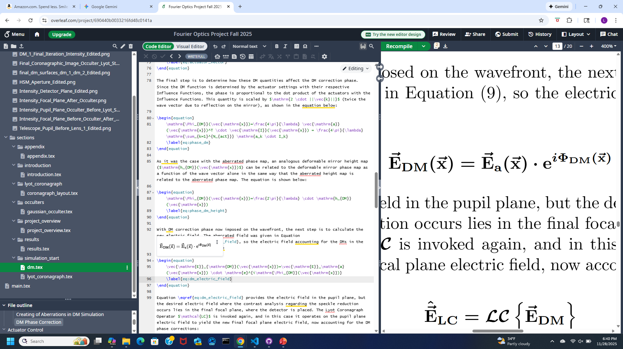
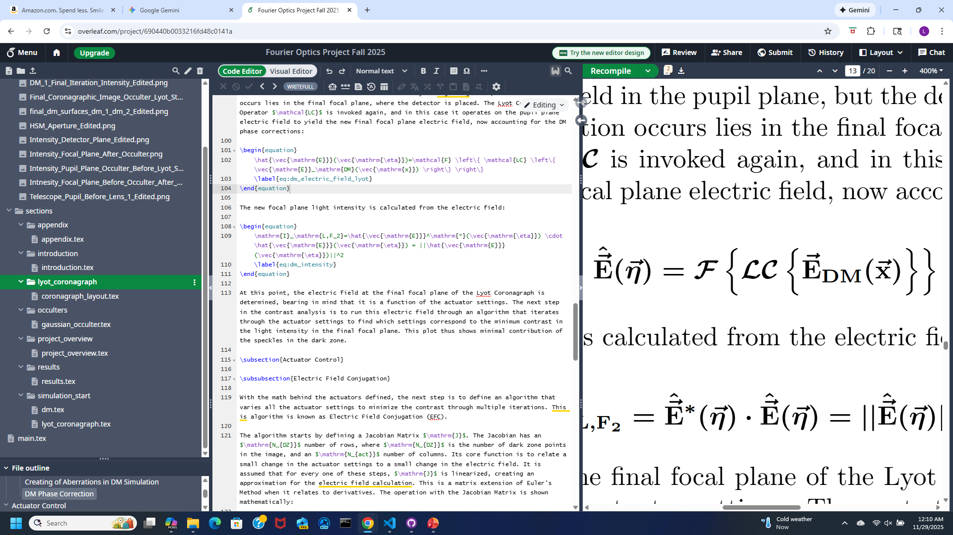
DMs

Slide 18
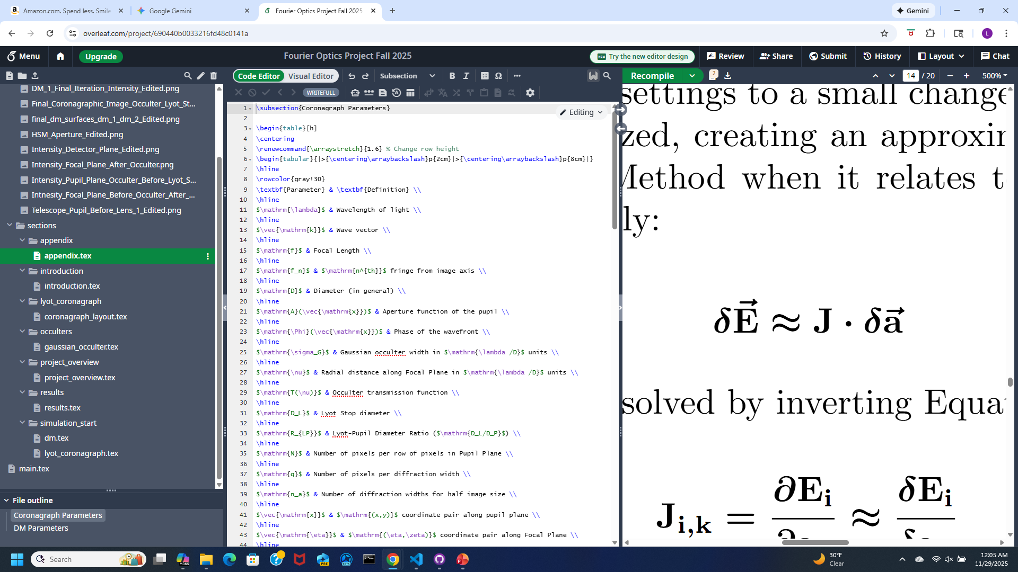
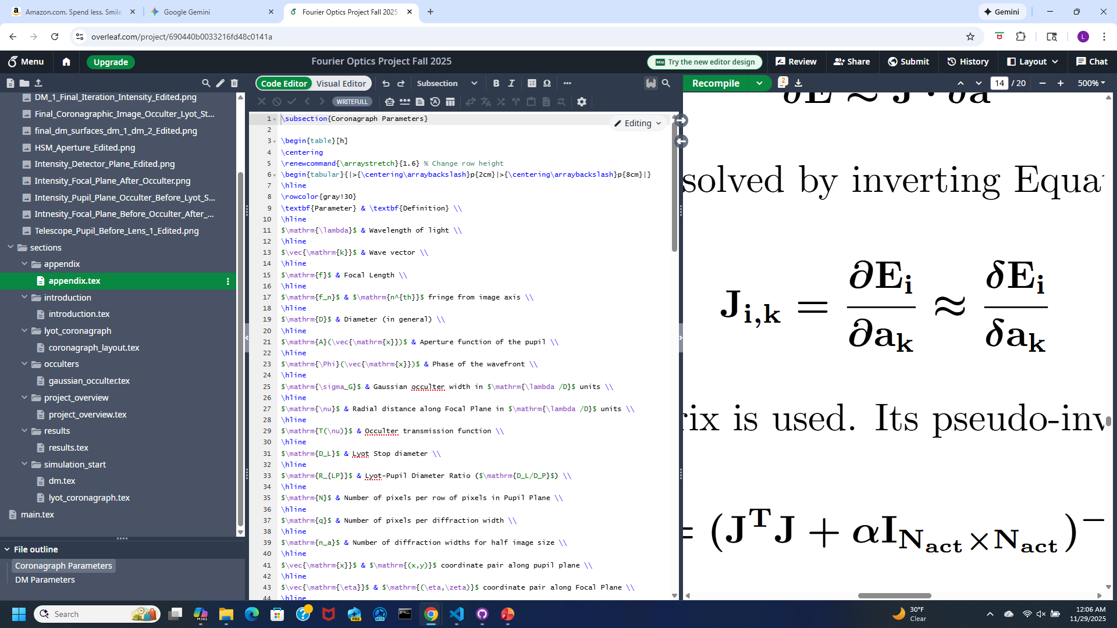

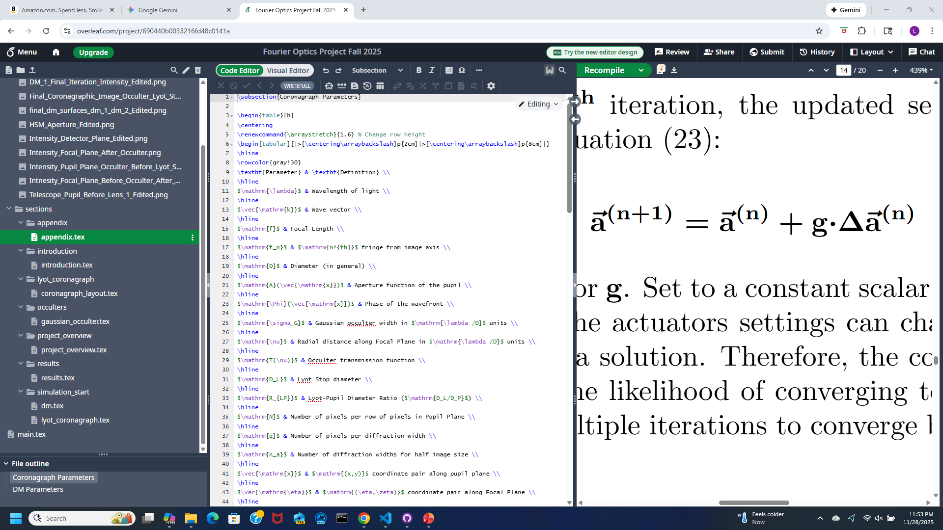
Actuator Correction

Slide 19
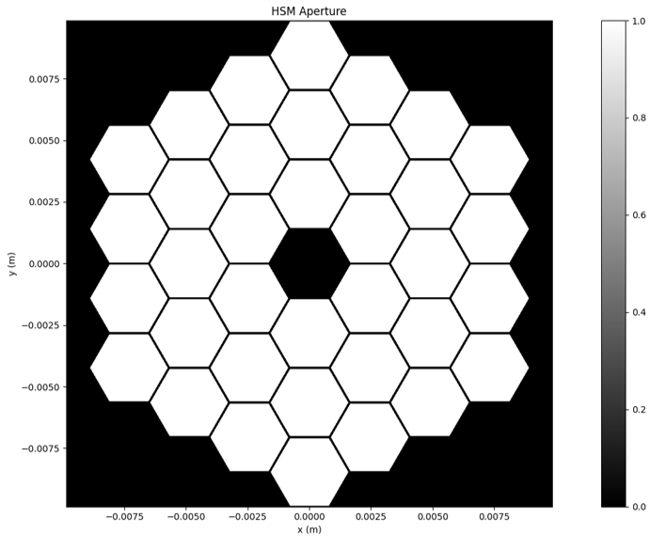
HSM in Pupil Plane

Slide 20
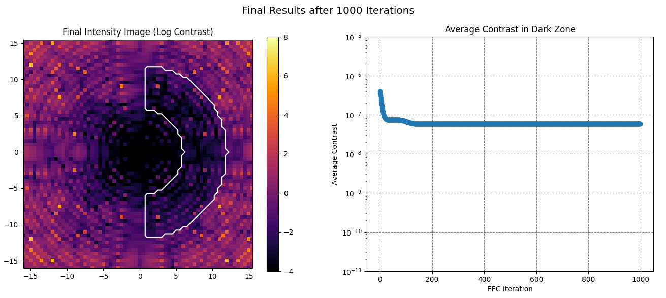
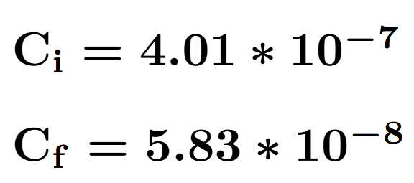

Slide 21
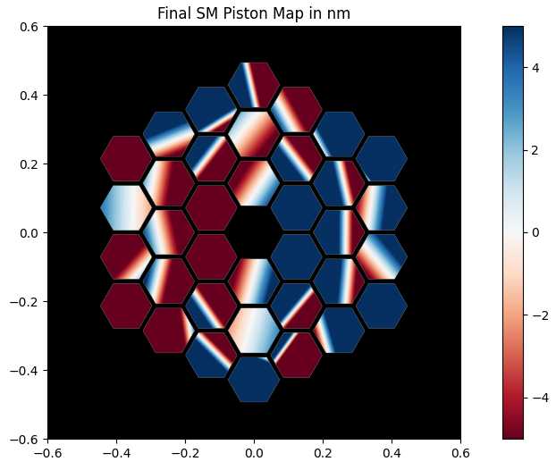

Slide 22
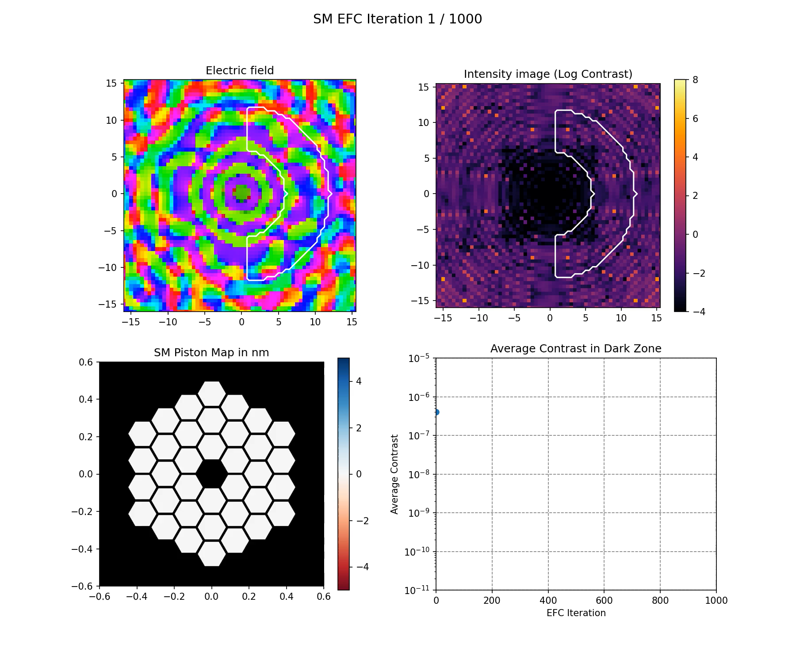

Slide 23

Continuous DM in Pupil Plane

Slide 24
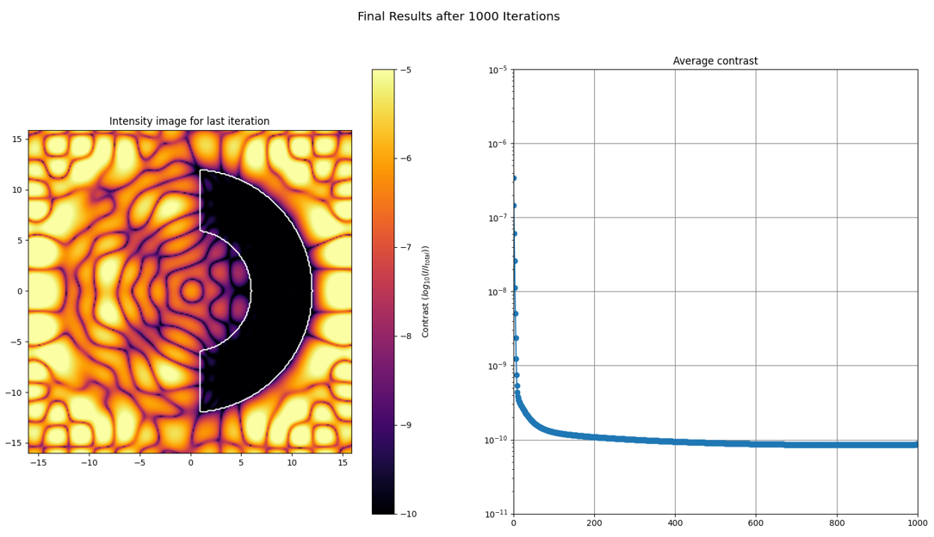
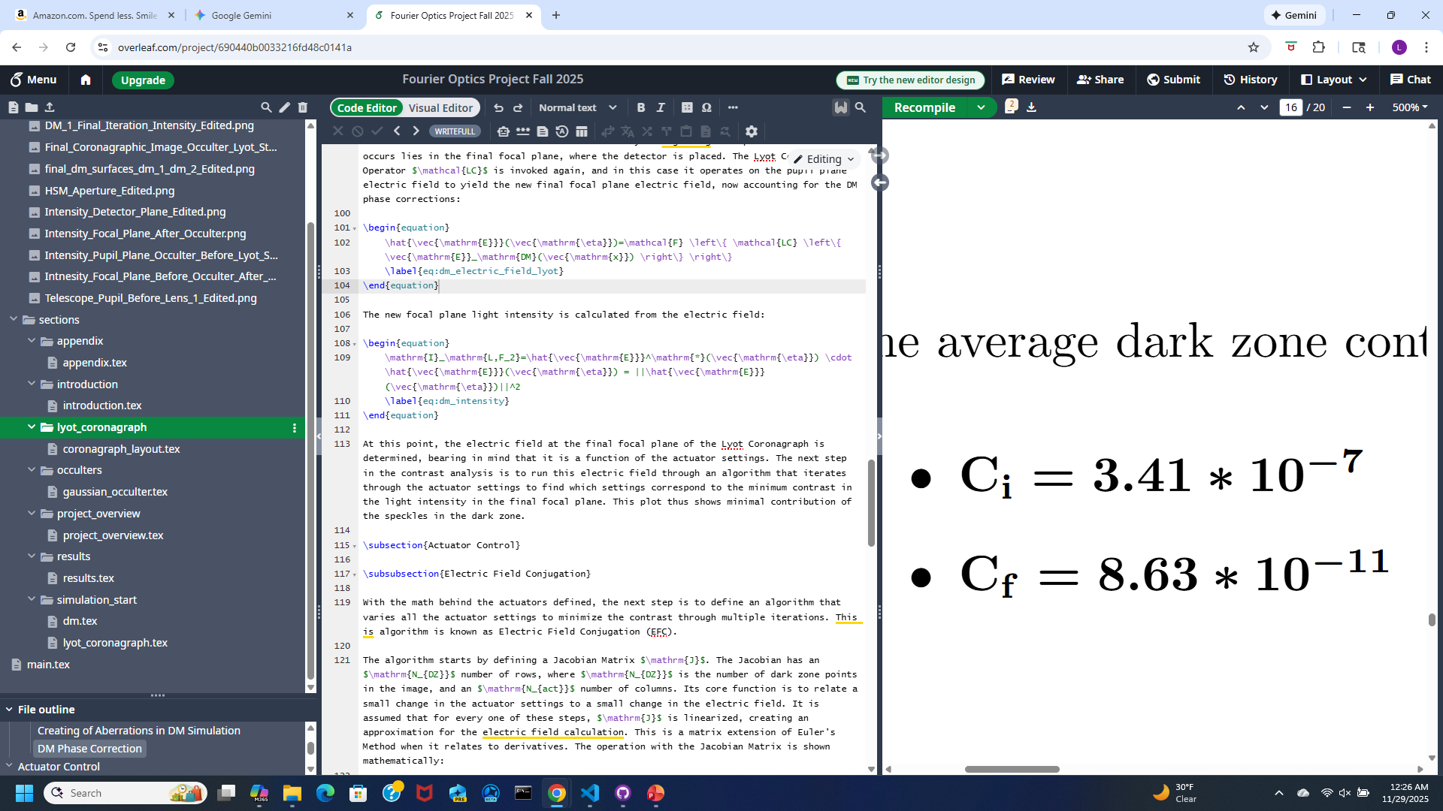

Slide 25
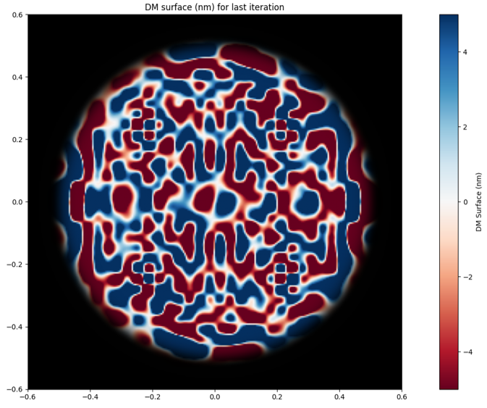

Slide 26
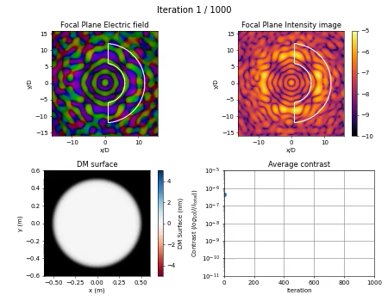

Slide 27

1 Continuous DM in Pupil Plane + 1 Continuous DM in Lyot Plane

Slide 28
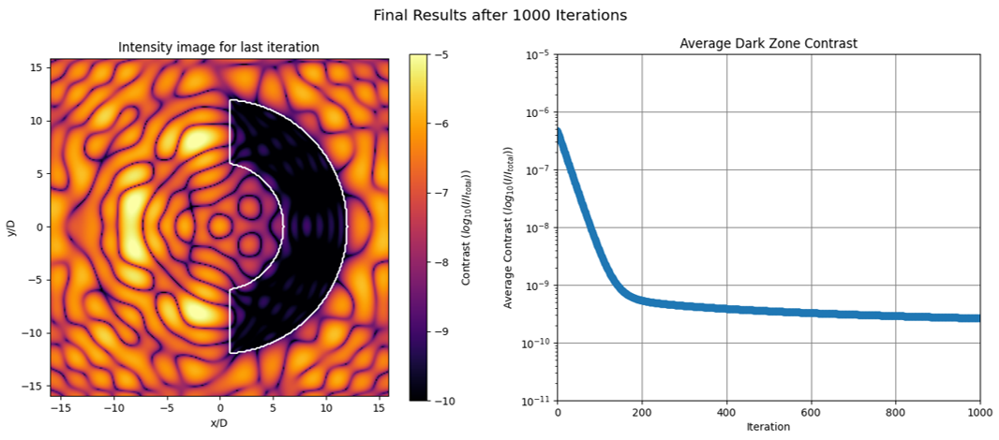
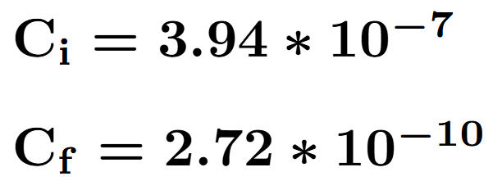

Slide 29
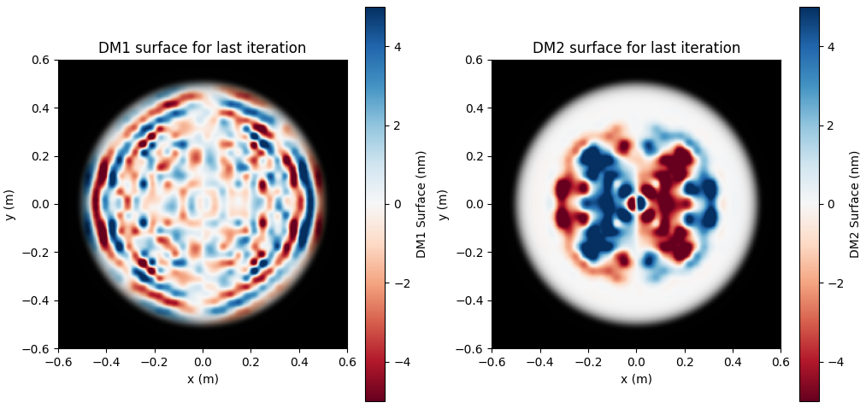

Slide 30
